Slide 1


Mac Installation & Activation -Basic Troubleshooting-

Slide 2
Topics to be covered
Mac Terminology
Office for Mac Installation
Uninstall Office from Mac
Removal Tools available for Mac
Troubleshooting signing issues using Mac’s Keychain tool.

Slide 3

Mac Terminology

Slide 4
About Mac users…
MacOS has its own way of naming things. Something that we need to keep in mind is that many Mac users are fans of the Apple products they own, therefore some of them may feel uncomfortable if we do not name things correctly.
The next slide will display some components of the MacOS user interface and its closest equivalent found in a Windows system.

Slide 5
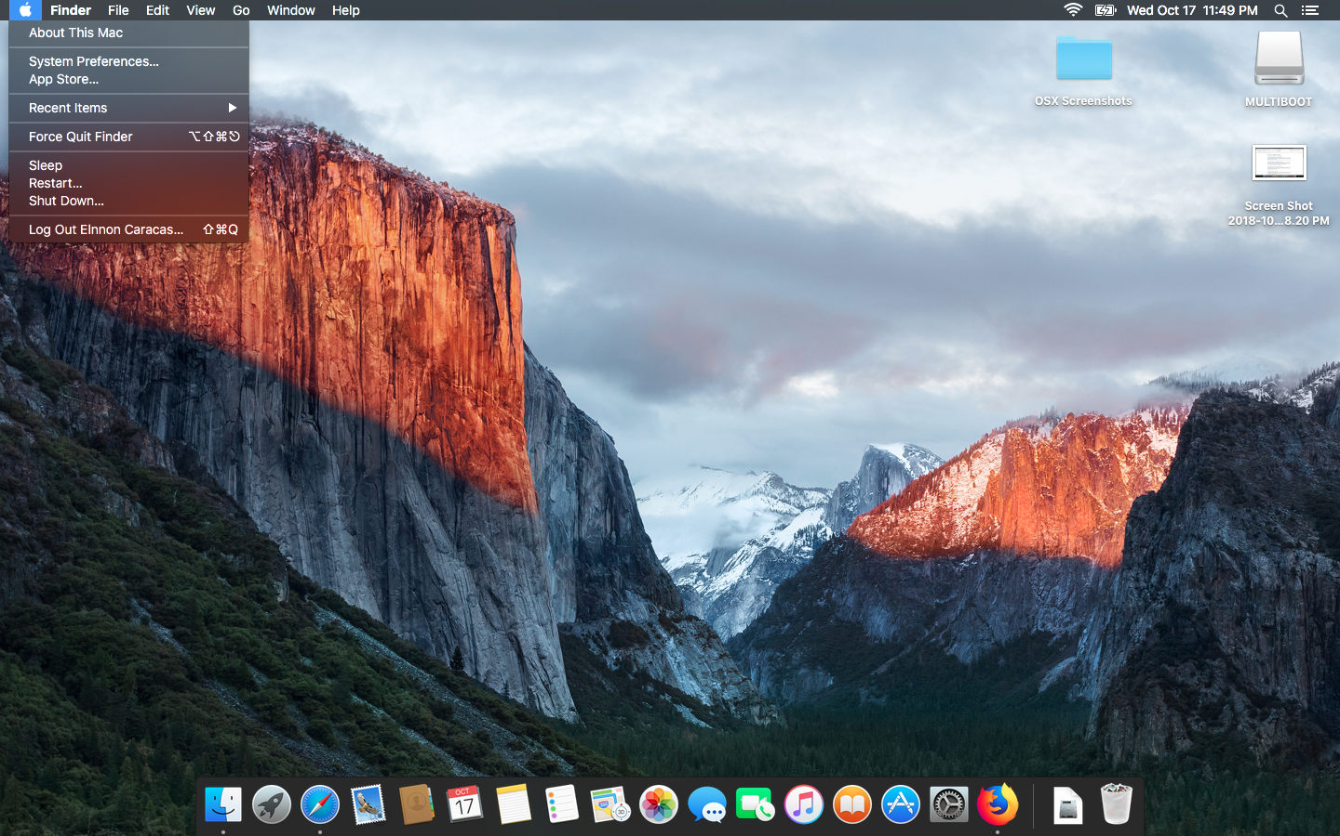
The MacOS Desktop

Slide 6


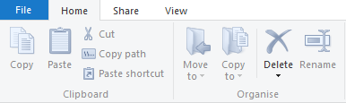



Mac Item
Windows Equivalent
Finder
Application Menu
Dock
Windows Explorer
Ribbon Menu
Taskbar

Slide 7

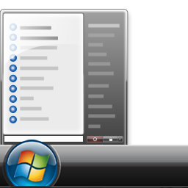




Mac Item
Windows Equivalent
Launchpad
Alias
System Preferences
Start Menu
Shortcut
Control Panel

Slide 8




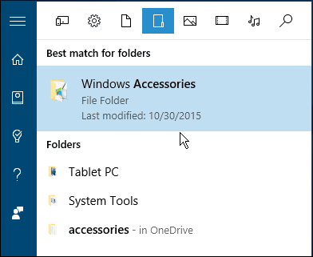


Mac Item
Windows Equivalent
Terminal
Utilities
Trash can
Command Prompt/PowerShell
Windows Accessories
Recycle bin

Slide 9


Office for Mac Installation

Slide 10

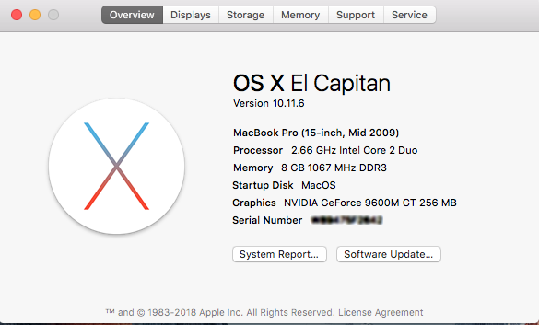
1. Check the MacOS version
You can achieve this by going to the apple ( )icon, and selecting the option “About this Mac”

Slide 11
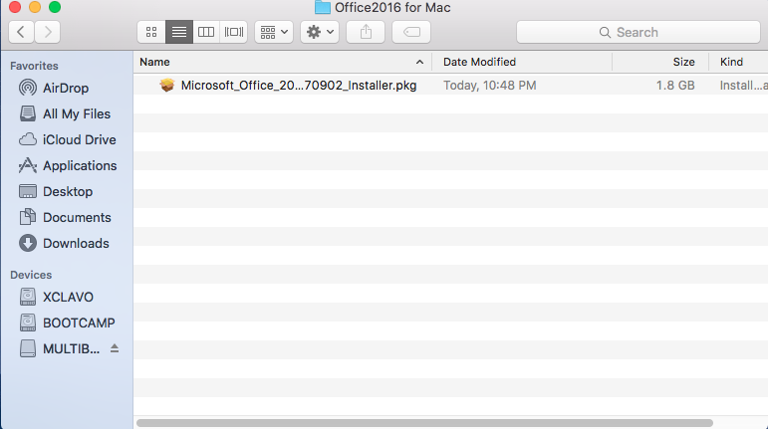
2. Get the Office for Mac Installer
Sign in to customer’s account through https://account.microsoft.com and download the installer through the “Services and Subscriptions” tab.

